Slide 1
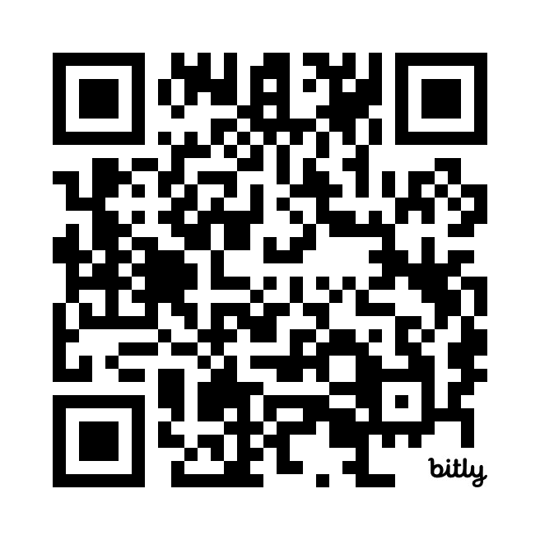
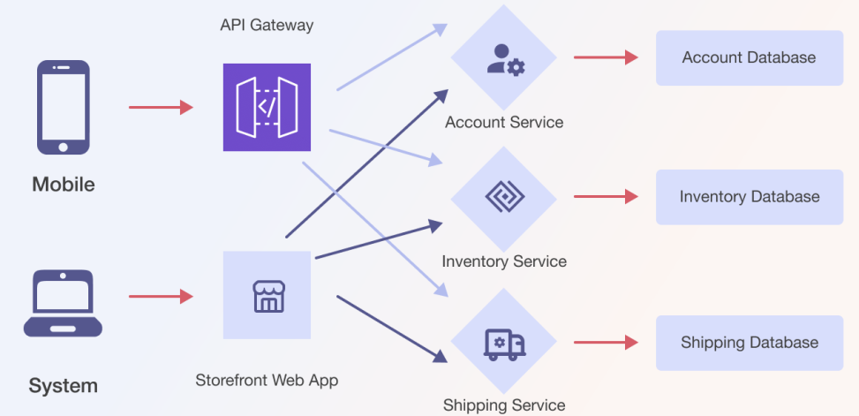
Introduction to Microservices Quiz
https://bit.ly/4aRpqaZ

